Slide 1
MECH5030M
Team Project
Week 11 recap
Module leader: Dr Mike Bryant
Room 2.31
m.g.bryant@leeds.ac.uk

Slide 2
Undertaking the Project
Solve any team problems as early as possible
Make agendas
Keep minutes
Keep a personal log book to submit with your final report
Self-check: am I spending 2-3 days (16-24 hours) a week working on your project???

Slide 3
Project Showcase
Week 15 – 3rd Feb
Produce a scientific poster on your progress to date
Opportunity to share your work (logistics to be confirmed)
Present your technical progress to your examiner
Gauge your progress against other teams
Deliverable: Produce and present a scientific poster detailing your work to date.

Slide 4
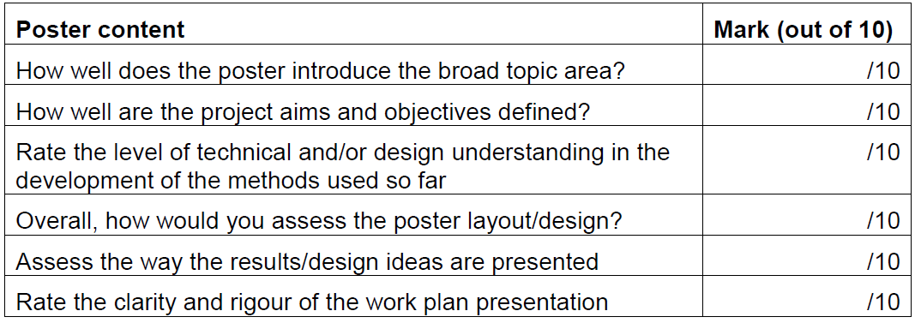
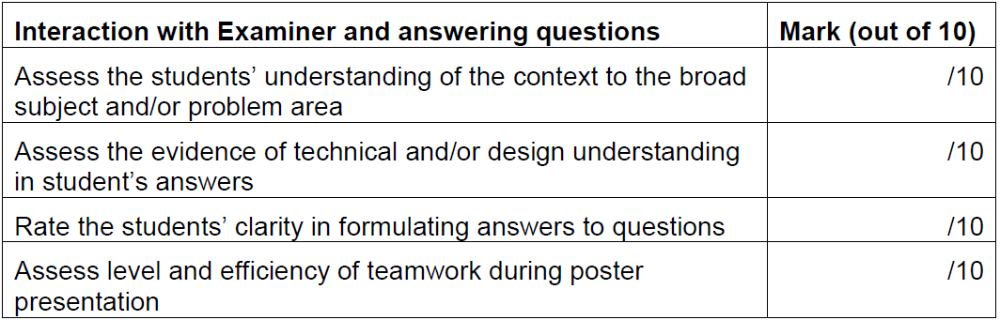
Poster: 10% of the final mark

Slide 5
Assessment
Contract Performance Plan (CPP) presentation: Request for proposal (RfP) to be given by the supervisor in the first week. CPP to be developed based on the RfP. CPP assessed via student peer assessment in week 9 and 10.
Team project poster showcase: Poster on progress to date, submission week 15
To be completed …..
Team and individual reports: Submission in week 23. By supervisor + examiner (+ third marker if not within 10%)
Presentation: 60 mins team - 20mins precise team presentation + 10 mins individual presentation (5mins for questions)
Conduct (including meeting log): ahead of exam boards – by supervisor
Ethics submission: set and assessed by IDEA in week 3/4, submission week 24.

Slide 6
Questions?
MS Teams or m.g.bryant@leeds.ac.uk

